Slide 1
Debugging
The process of identifying and removing errors from process.
Whenever an activity has errors, UiPath Workflow Designer notifies and gives you details about the issue encountered.
UiPath Studio comes with a debug component that helps find and locate problems easily in complex workflows. This is useful for viewing the execution of each activity to verify what data it gets and in checking if there are errors in producing outputs.

Slide 2
Basic Debugging Features and Interfaces
Use the debugging actions in UiPath Studio;
Use breakpoints;
Use the Run from this activity and Run to this activity actions;
The Debugging Interface
Running Workflow in Debug mode
Catching Errors
Using the Debug Ribbon actions
Using Local Panel

Slide 3
BreakPoints
Breakpoints are used to purposely pause the debugging process on an activity which may trigger execution issues. You can place a breakpoint on any activity either by selecting it and clicking the Breakpoints button on the Execution tab.
Run from this activity and Run to this activity
Test Activity
Watch Panel, Call Stack panel, Immediate panel

Slide 4
Practice - Fix My Workflow
Debug your colleague's workflow
Your colleague was tasked with creating a Proof of Concept that can demonstrate UiPath's adaptability to changing interfaces. The robot needs to extract the first name, last name, phone number and company name from www.fakenamegenerator.com and insert them in the correct fields on rpachallenge.com.

Slide 5
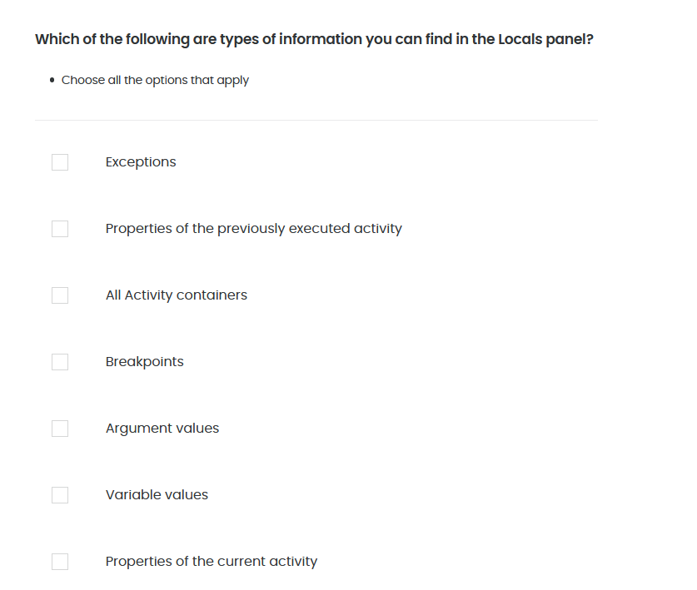
Quiz 01/10

Slide 6
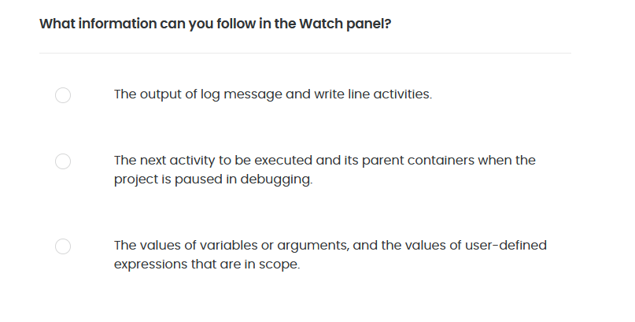
Quiz 02/10

Slide 7
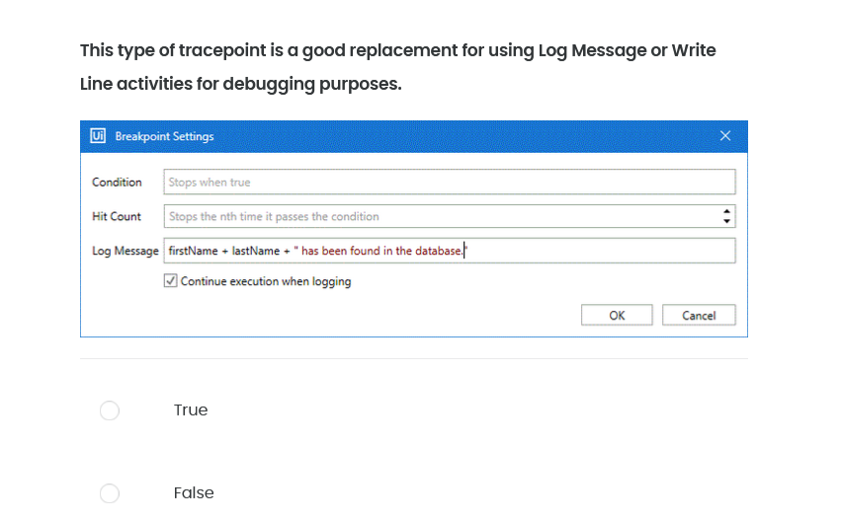
Quiz 03/10

Slide 8
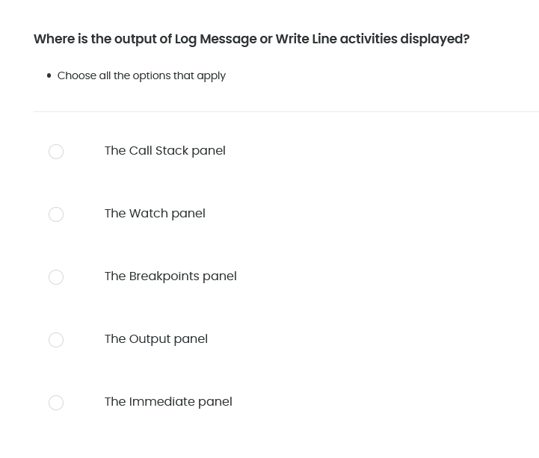
Quiz 04/10

Slide 9
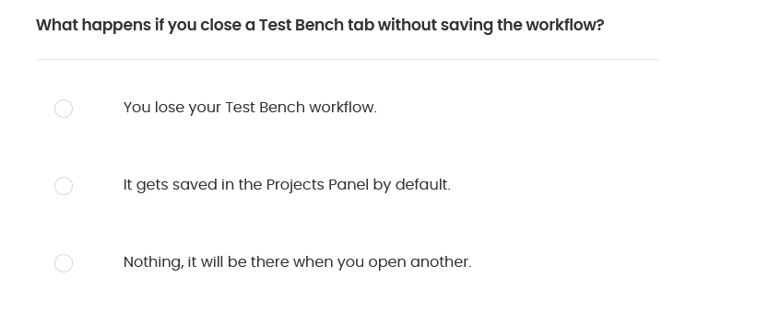
Quiz 05/10

Slide 10
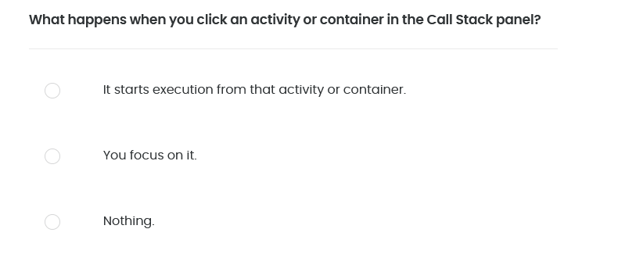
Quiz 06/10

Slide 11
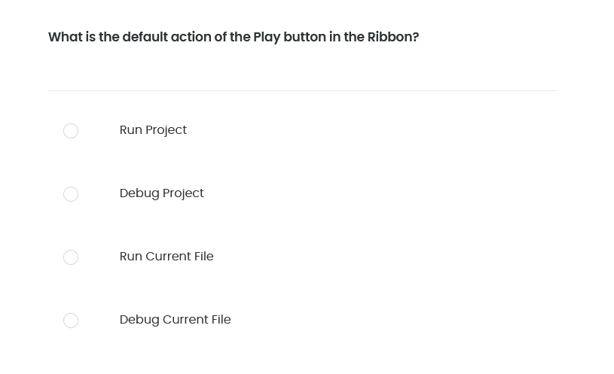
Quiz 07/10

Slide 12
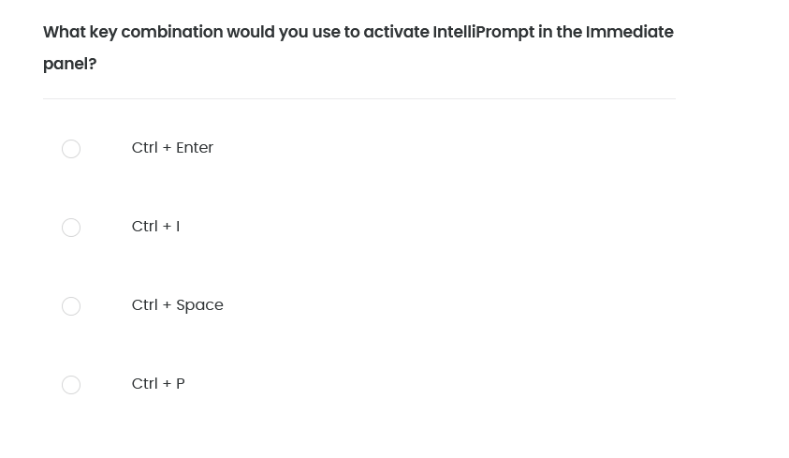
Quiz 08/10

Slide 13
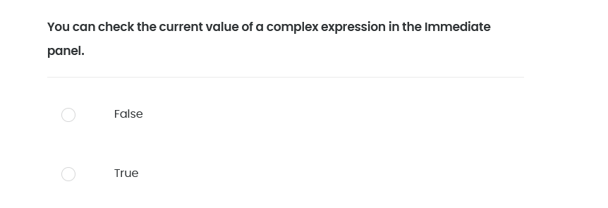
Quiz 09/10

Slide 14
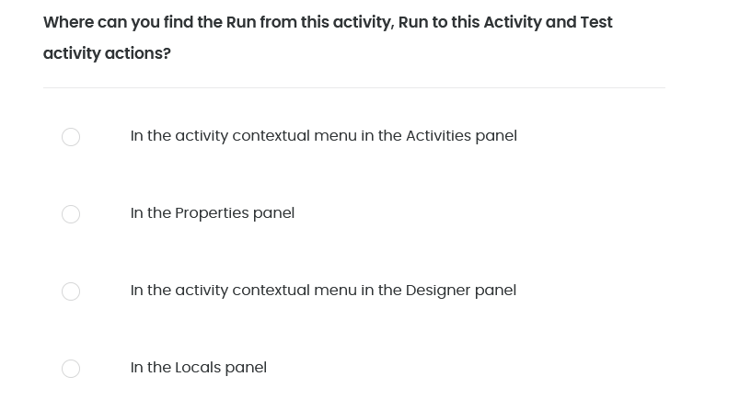
Quiz 10/10

